Slide 1
24MAT120
S2 P & M

Slide 2

In single variable functions , we found that if a function y= ƒ(x) is differentiable at x = x0, then the change ∆y resulting in the change of x from x0 to x0 + ∆x is close to the change ∆L along the tangent line (or linear approximation L of the function ƒ at x0).
The extension of this result is what we use to define differentiability for functions of two variables.

Slide 3
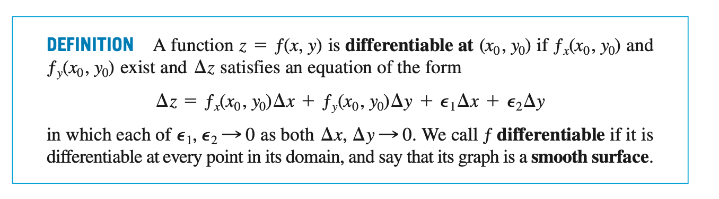

Slide 4
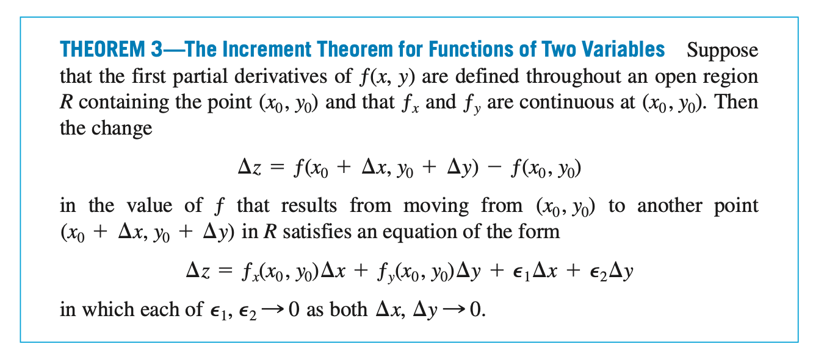

Slide 5
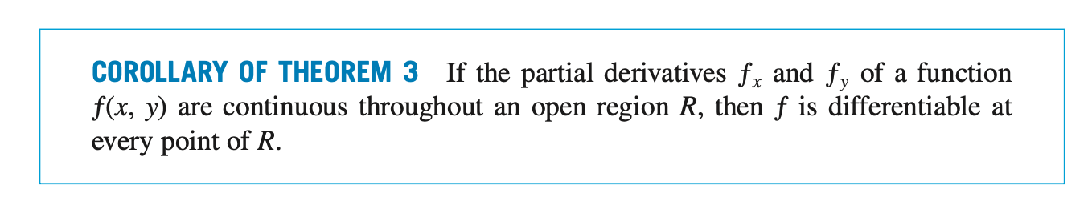

Slide 6
